Slide 1
DigTheWord
Copyright (C) 2015 Chandhni Kannatintavida
This project is licensed under the "MIT License". Please see the file:
"License.md"(https://github.com/chand008/DigTheWord/blob/master/License.md)
in this distribution for license terms.
Presented by:
Chandhni Kannatintavida

Slide 2
DigTheWord
MIT License
Android studio, SQLite database
Presented by:
Chandhni Kannatintavida

Slide 3
Target Audience
Anyone who loves word games!
Notes:
http://www.brazencareerist.com/blog/2013/08/06/startup-vs-big-company-which-is-better-for-your-career/
http://eqli.st/startup-need-employer-branding/

Slide 4
Demo
Notes:
http://www.brazencareerist.com/blog/2013/08/06/startup-vs-big-company-which-is-better-for-your-career/
http://eqli.st/startup-need-employer-branding/

Slide 5
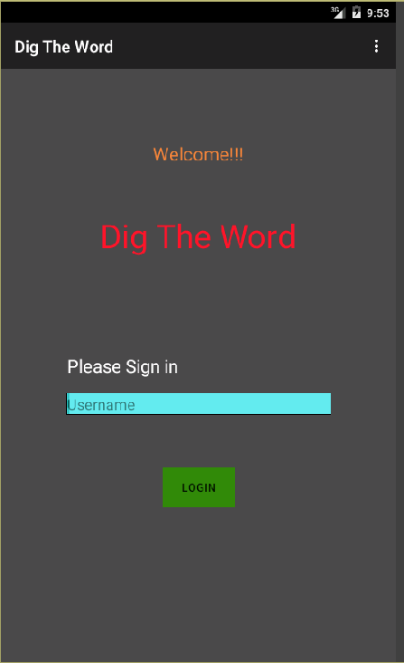
Notes:
http://www.brazencareerist.com/blog/2013/08/06/startup-vs-big-company-which-is-better-for-your-career/
http://eqli.st/startup-need-employer-branding/

Slide 6
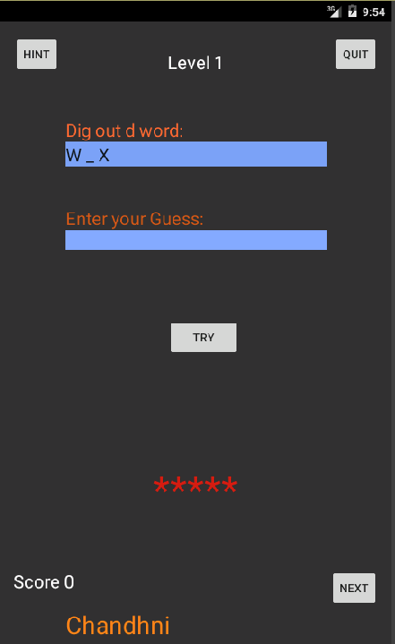
Notes:
http://www.brazencareerist.com/blog/2013/08/06/startup-vs-big-company-which-is-better-for-your-career/
http://eqli.st/startup-need-employer-branding/

Slide 7
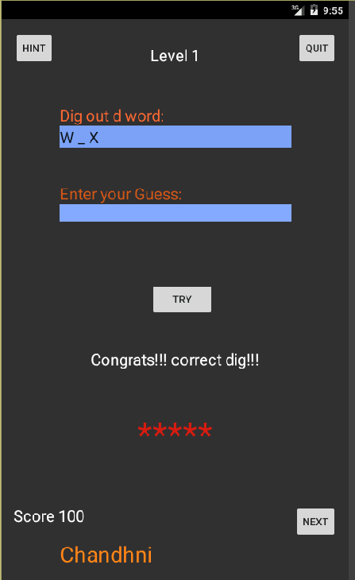
Notes:
http://www.brazencareerist.com/blog/2013/08/06/startup-vs-big-company-which-is-better-for-your-career/
http://eqli.st/startup-need-employer-branding/

Slide 8
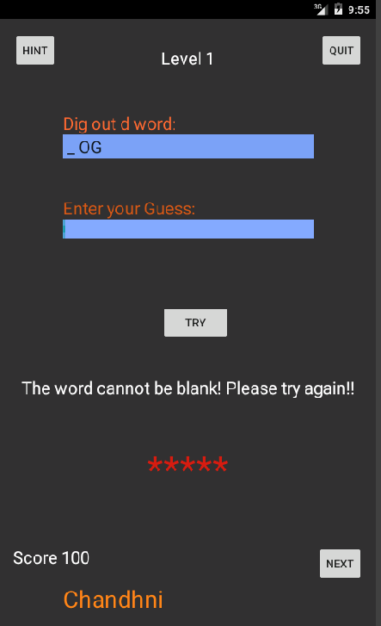
Notes:
http://www.brazencareerist.com/blog/2013/08/06/startup-vs-big-company-which-is-better-for-your-career/
http://eqli.st/startup-need-employer-branding/

Slide 9
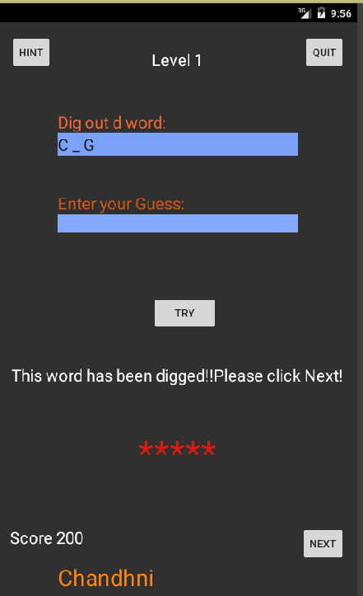
Notes:
http://www.brazencareerist.com/blog/2013/08/06/startup-vs-big-company-which-is-better-for-your-career/
http://eqli.st/startup-need-employer-branding/

Slide 10
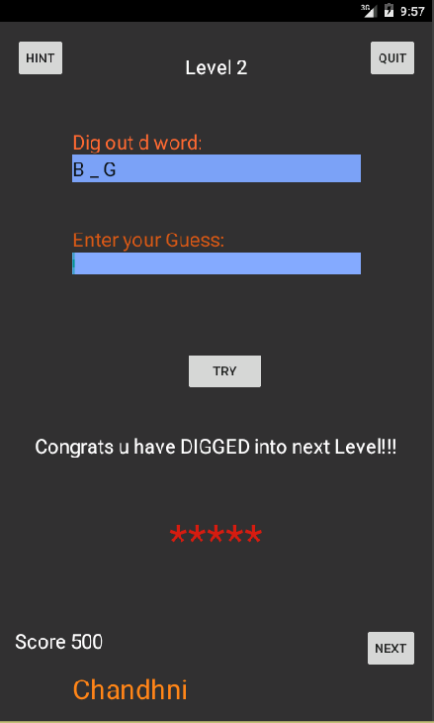
Notes:
http://www.brazencareerist.com/blog/2013/08/06/startup-vs-big-company-which-is-better-for-your-career/
http://eqli.st/startup-need-employer-branding/

Slide 11
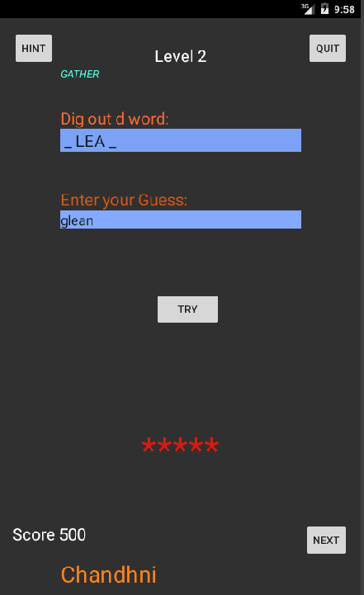
Notes:
http://www.brazencareerist.com/blog/2013/08/06/startup-vs-big-company-which-is-better-for-your-career/
http://eqli.st/startup-need-employer-branding/

Slide 12
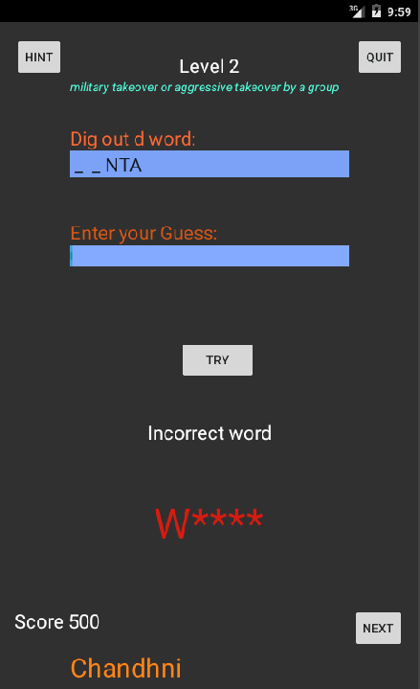
Notes:
http://www.brazencareerist.com/blog/2013/08/06/startup-vs-big-company-which-is-better-for-your-career/
http://eqli.st/startup-need-employer-branding/

Slide 13
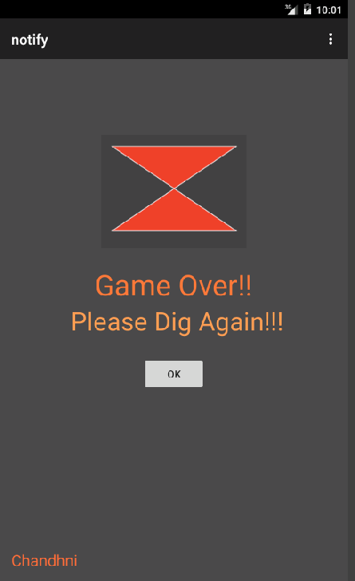
Notes:
http://www.brazencareerist.com/blog/2013/08/06/startup-vs-big-company-which-is-better-for-your-career/
http://eqli.st/startup-need-employer-branding/

Slide 14
Challenges and Learning
Setting up the project
Debugging in android studio
Git, SQLite,xml, android studio
Implement the project in increments
Make decisions regarding features quickly so that it does not compromise the functionality of the app.

Slide 15
Future Scope
Create categories for words like science and technology,sports etc.
Create a screen after the login for users to select the level they wish to play .
Upgrade to grid type challenge screen, from free text screen
Incorporate time limit for guessing the word.
Updation of score based on time and use of hints
Improve the look of app.
Notes:
Create categories for words like Science and technology, History etc
Create a screen after the login(main activity) for users to be able to select the level they wish to play.
Incorporate the time limit for guessing the word.
Updation of score based on time and use of hints.
Improve the look of the app.

Slide 16

Questions
“The question is not what you look at, but what you see.”

